Slide 1
Forecasting Ride-hailing across Multiple Model Frameworks
Christopher Day

Slide 2
Introduction

Slide 3

Ride-hailing & On-demand Transit
Technology-enabled shared public transit
Sustainable
Congestion
Cost effective
Carbon footprint
First-last mile

Slide 4




Modeling Ride-hailing Services
Geographic Locations
Trip Purpose
Passenger Characteristics
Chaining Modes

Slide 5
Existing Modeling Approaches

Slide 6
Spatial / Statistical Models
Advantages
Disadvantages
Simple
Replicable
Decreased Flexibility
Unable to forecast services simultaneously
Example
Hosseinzadeh et al. (2020)
Land use, age, demographics for e-scooter use
No travel time or level of service

Slide 7
Activity-based Models
Advantages
Disadvantages
Behavioral Representation
Modal consistency
Lack variability
Vehicle service not tracked
Example
Nguyen et al. (2022)
Modal consistency while modeling one-way carsharing
Difficult to verify service capabilities

Slide 8
Multi-agent Simulation
Advantages
Disadvantages
Realistic
Service Capabilities
Ridership
May not equate to real world accuracy
May lack modal consistency
Computationally heavy
Example
Horl et al. (2019b)
Detailed vehicular model of shared autonomous vehicles
Estimate overall system performance

Slide 9
Paired Modeling Approaches
Advantages?
Disadvantages?
Joint advantages
Overcome weaknesses
Too complicated
Extra calibration / validation
Example
Moeckel et al. (2020)
Microsimulation Transport Orchestrator (MITO)
Simulates individual agents, allows agent tracing, not as computationally heavy

Slide 10
Problem Statement
Multi-agent Simulation
Activity-based Model
No clear methodological approach
Forecasting ridership and level of service is challenging
Let’s try different combinations!
Ridership and Level of Service

Slide 11
Methods
ActivitySim
BEAM

Slide 12
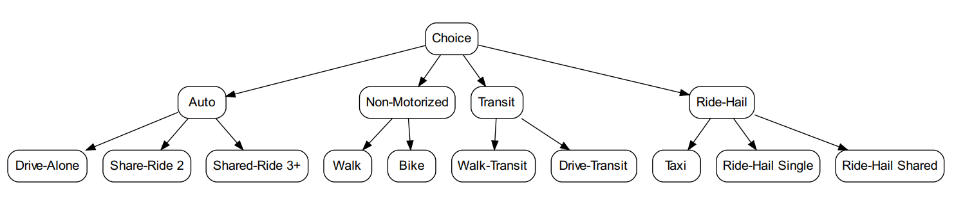
ActivitySim
Open-source activity-based model that represents the choices of people throughout the day.
Ride-hailing
Ride-hail and pooled ride-hail
Path, person, and location attributes
Configuration
Inputs
Synthetic population
Socioeconomic data
Skims
Calibration / Validation

Slide 13
BEAM
Multi-agent simulation that simulates individual agents with within-day and across-day replanning.
Ride-hailing
Configuration
Ride-hail and pooled ride-hail
Greedy asynchronous ride-hailing matching algorithm
Vehicle fleet
Vehicle tracking
Ride-hail requests
Passenger capacity
Variable wait time
Inputs
Daily activity plans from ActivitySim
Transportation Network
GTFS data

Slide 14
BEAM Mode Choice Utility Functions
Original
$${V_{nk} =α}_{k}+β_{k}^{1}({cost}_{k,ij})+β_{k}^{2}({tv}_{k,ij})+β_{k}^{3}({xfer}_{k})$$
Improved (from ActivitySim)
$${V_{nk}^{Person} =α}_{kn}+β_{kP}^{1}({cost}_{k,ij})+β_{kP}^{2}({age}_{n})+β_{kP}^{3}({hhsize}_{n})$$
${V_{nk}^{Path} =β}_{kP}^{4}({dist}_{k,ij})+β_{kP}^{5}({tv}_{k,ij})+β_{kP}^{6}({te}_{k})$ + $β_{kP}^{7}\left({tw}_{k}\right)+$
${ β}_{kP}^{8}({prox}_{k})+β_{kP}^{9}({xfer}_{k})$
${V_{nk}^{Location}=β}_{kP}^{10}({ZDI}_{k,i})+β_{kP}^{11}({ZDI}_{k,j})+β_{kP}^{12}({ZTI}_{k,j})$ + $β_{kP}^{13}\left({CBD}_{k,j}\right)$
$${V_{nk} =V}_{nk}^{Person}+ V_{nk}^{Path}+ V_{nk}^{Location}$$

Slide 15
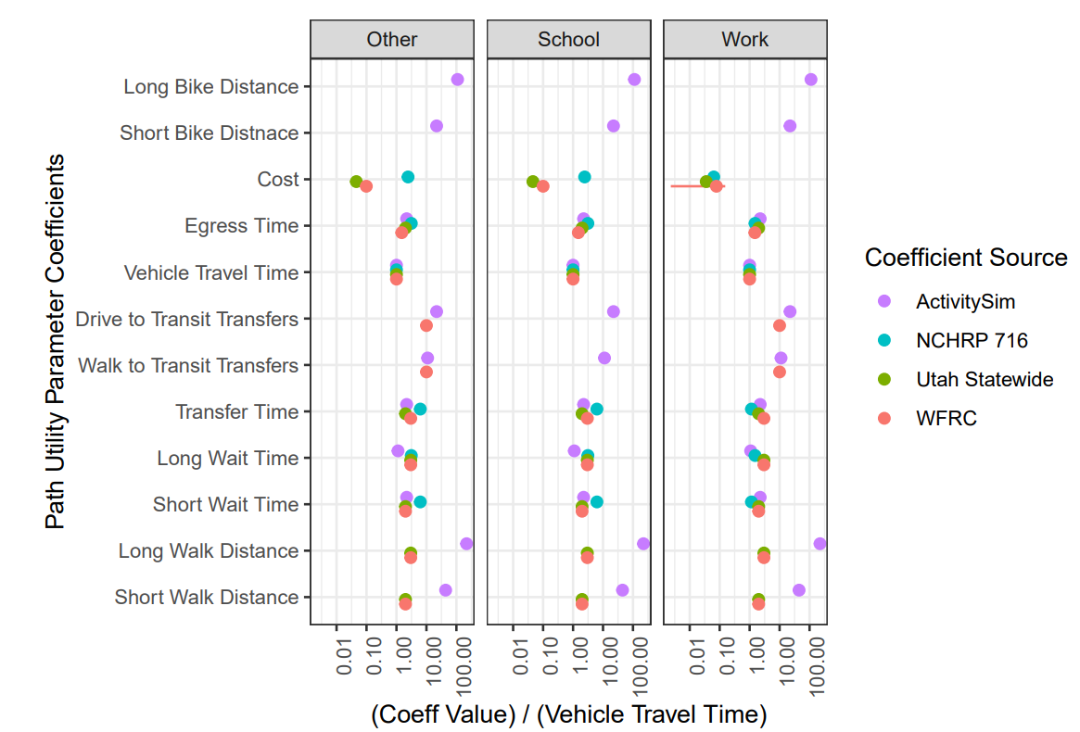
Path Utility Coefficient Validation

Slide 16
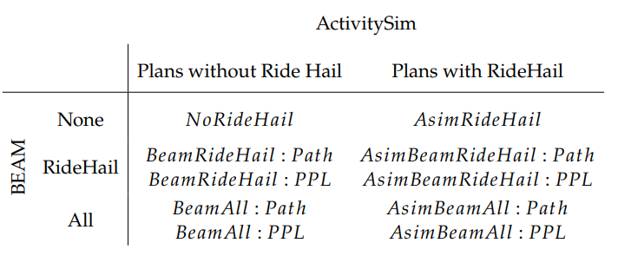
Mode Choice Combination Scenarios
None – Modal innovation turned off
RideHail – Only walk and transit modes
may switch to ride-hail
Path – Only path utility parameters used
All – All modes may switch to
ride-hail
PPL – All path, person, and location utility parameters used
Beam –
Input plans without ride-hail
AsimBeam –
Input plans with
ride-hail

Slide 17
Results

Slide 18
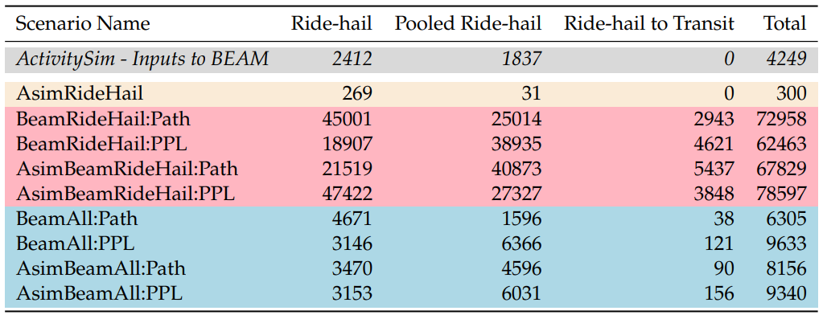
Ride-hail Ridership
Ride-hail Trip Ridership
Ridership affected significantly by BEAM mode choice structure
Notes:
Also describe why the magnitude is so different.

Slide 19
Ride-hail Ridership
Ride-hail Trip Ridership
Ridership is not significantly affected by ride hail in the initial plans

Slide 20
Ride-hail Ridership
Ride-hail Trip Ridership
3. Using path, person, and location variables estimate more ridership than path

Slide 21
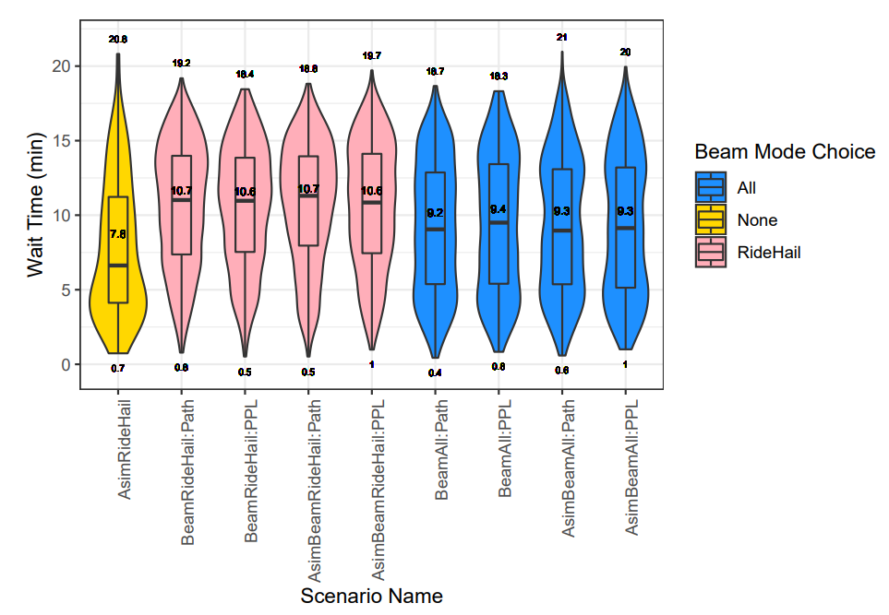
Ride-hail Wait Times
Wait Time
Dependent on BEAM mode choice
None – Bottom Heavy
All – Even Spread
RideHail – Top Heavy
Not significantly affected by input plans or utility parameters
All wait times < 25 mins
Function of Utilization

Slide 22
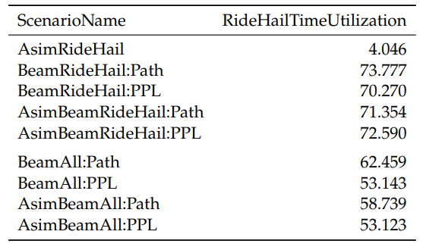
Ride-hail Utilization
Percent Ride-hail Time Utilization
Utilization affects both ridership and wait times
952 driver shifts
Percent of total ride hail time available by total ride hail travel time

Slide 23
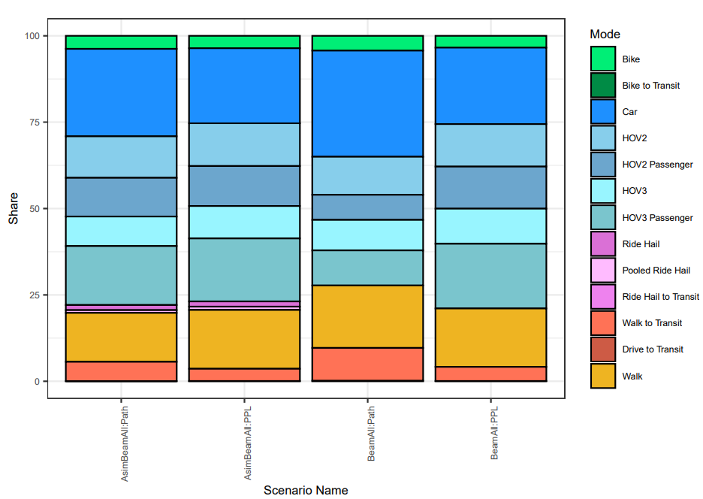
Switch to Ride-hail
Why do so many car and walk users switch to ride-hail?
~75% Car Modes

Slide 24
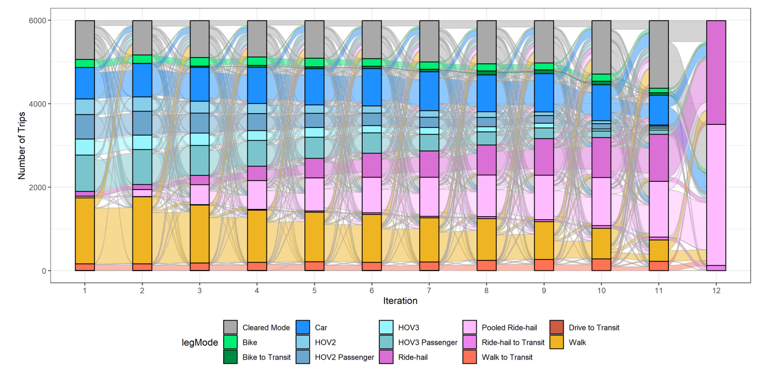
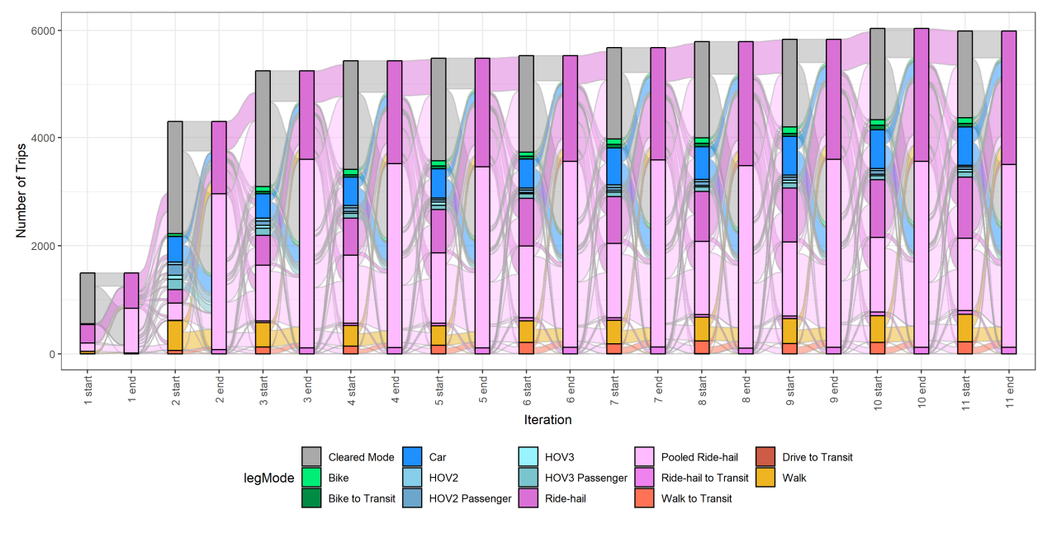
Switch to Ride-hail
Ride-hail is an attractive alternative
AsimBeamAll:PPL scenario
Notes:
Top: Selection process of agents who use ride-hail on the final iteration
Bottom: Starting choice of agents who switch to ride-hail by iterations end

Slide 25
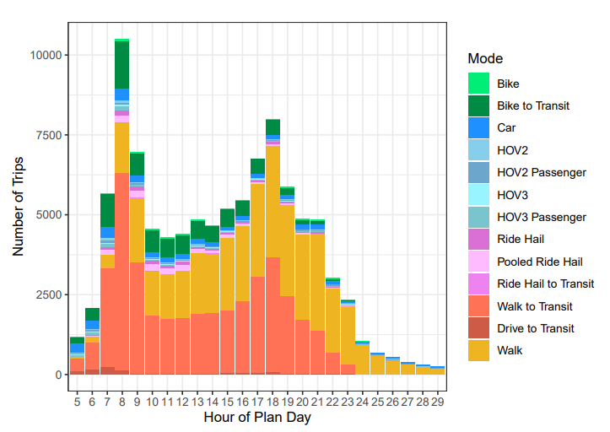
Switch to Walk
Agents lose their car
Vehicle assignment model
Unable to build path
AsimBeamAll:PPL scenario

Slide 26
Discussion + Conclusion

Slide 27
Discussion
Mode choice structure affects ridership and level of service forecasts
Utility function
Programming of choice structure
Increased complexity may cause irrational results
Vehicular assignment model
Overstated demand
Other limitations
Calibration
Network
Iterations
Driver Fleet

Slide 28
Conclusion
Feedback loop may improve ridership and level of service forecasts
Iterative process
Consistent mode choice structure
We should use the best approaches available
Sustainability
Activity-based Model (ActivitySim)
Ridership
Multi-agent Simulation (BEAM)
Travel & Wait Times

Slide 29
Thank you

Slide 30
Additional Slides

Slide 31
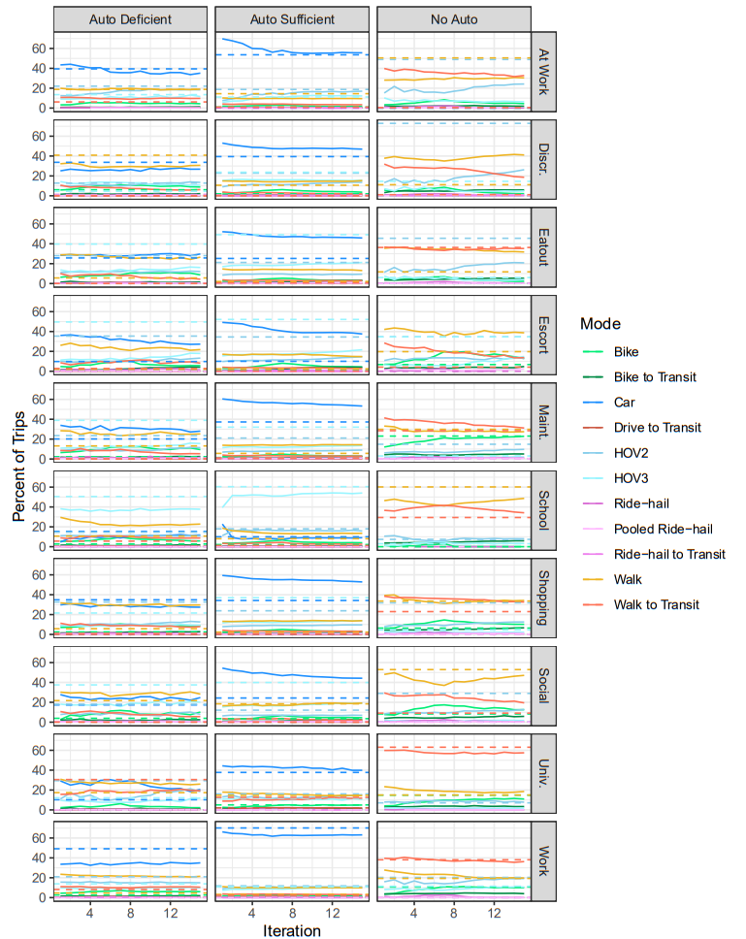
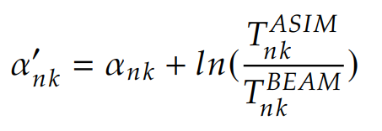
Mode Choice Utility Constant Calibration

Slide 32
We feel disconnected over here.
Victoria Petro-Eschler
as qt. in DeseretNews, 2021
Notes:
https://www.deseret.com/utah/2021/12/14/22834269/how-to-use-salt-lake-citys-new-uta-on-demand-microtransit-service-via

Slide 33
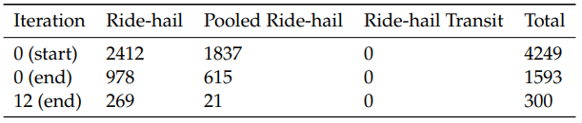
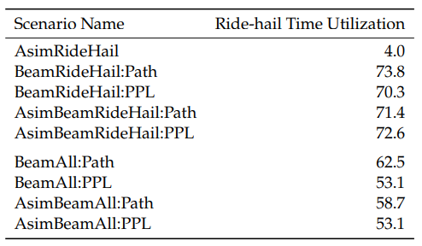
Mode Choice Model Effects
None Model
All Model
Loss of Ride-hailing Trips
Loss of initial ride-hailing trips
Car and walk users switch to ride-hailing modes
Attractive alternative
BEAM’s car tracking algorithm
Trip based mode choice
Percent Ride-hail Time Utilization
RideHail Model
Most users switch to ride-hailing
Adjusted code structure
Attractive alternative

Slide 34
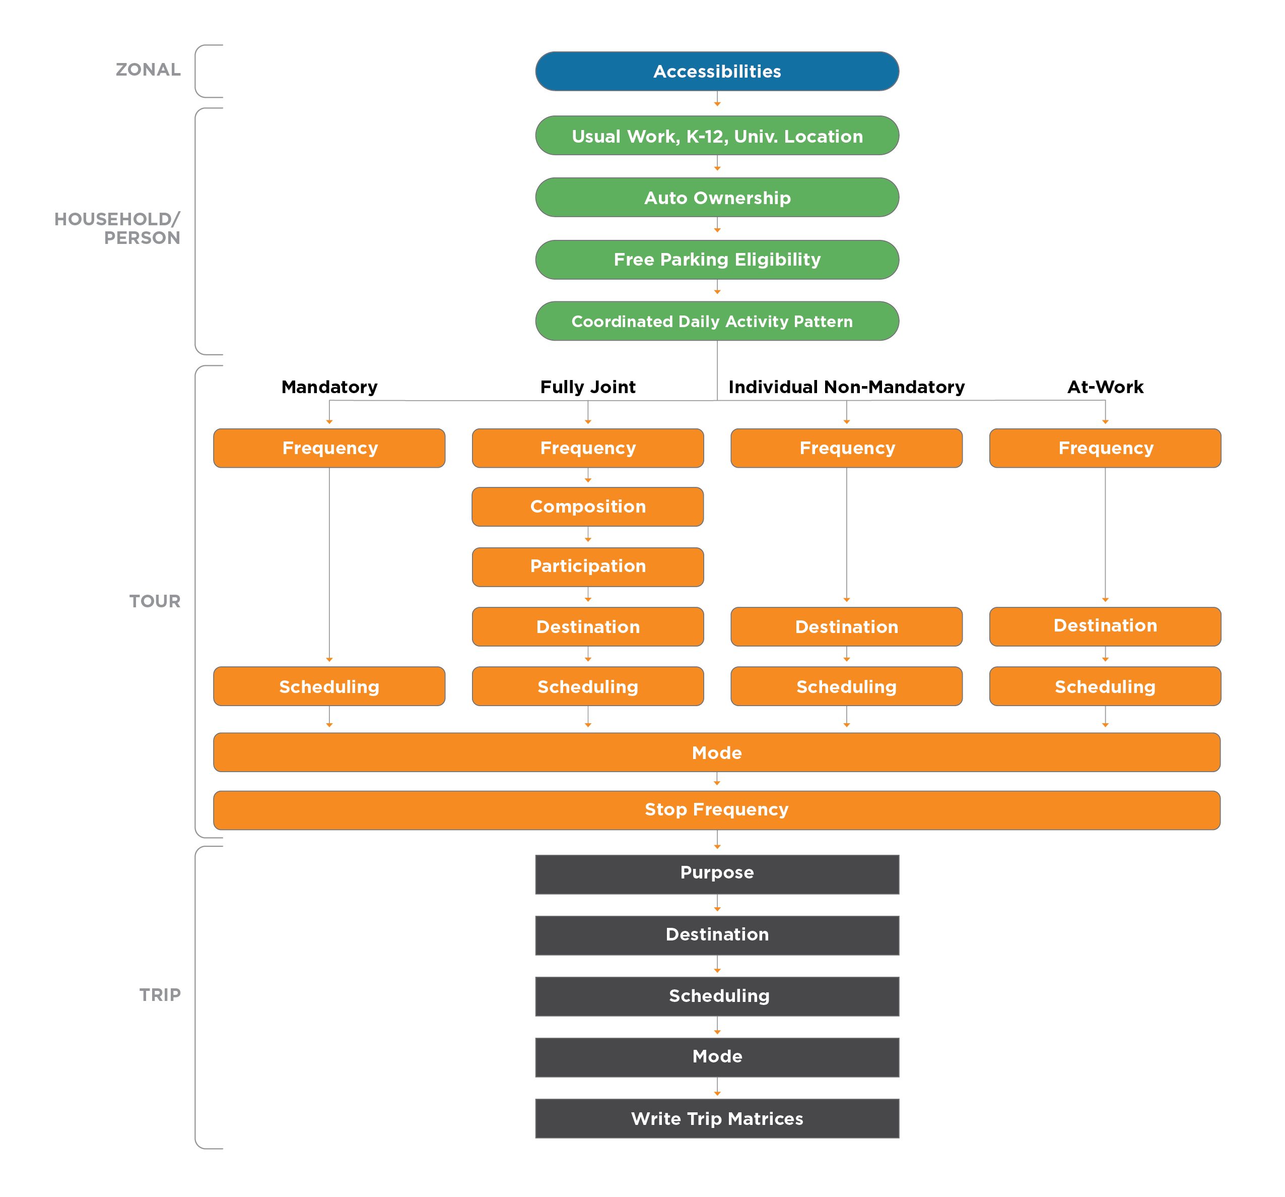
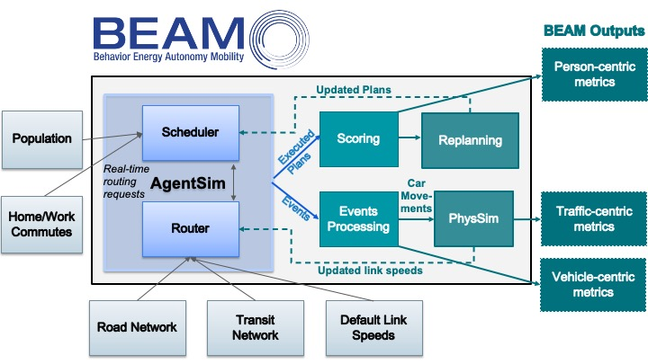
ActivitySim and BEAM
ActivitySim
BEAM
Configured for Salt Lake City metropolitan region
Provides initial plans for 2.4 million people
Iterative algorithm to improve individual plans through mode and route choice
Represent on-demand transit as pooled ride-hail
Operates in a defined area
Notes:
The activity-based model we have used for the Salt Lake City scenario is called ActivitySim. ActivitySim is an open-source, activity-based travel behavior modeling software that has the ability to generate plans for entire populations. In the case of Salt Lake City, ActivitySim provided the initial plans for 2.4 million people.
The simulation model we have decided to use for this project is called BEAM. BEAM is an open-source agent based regional transportation model. It is an extension / reimplementation of MATSIM. Part of its desirable attributes include a greedy asynchronous ride hail matching algorithm that includes options for pooled ride hail modes. The graphic on the slide gives a quick view into how BEAM actually works. One of the inputs to BEAM includes this population file, and for Salt Lake City that file was generated by ActivitySim.
BEAM also uses a very simplified mode choice. Currently, I are working on extending it to be more consistent with the model of ActivitySim. Part of that process involves adding a lot of variables in the mode choice calculation. In addition, I had to update BEAM’s code to include HOV and carpooling modes. In order to make sure the network didn’t over congest, some carpooling agents teleport.

Slide 35
Activity-based Models
Advantages
Disadvantages
Behavioral Representation
Modal consistency
Lack variability
Average wait / travel times
Skims
Vehicle service not tracked
Vehicle availability
Passenger capacity
Construct daily activity patterns for synthetic individuals from behavioral choice models
Example
Nguyen et al. (2022)
Modal consistency while modeling one-way carsharing
Difficult to verify service capabilities

Slide 36
Multi-agent Simulation
Advantages
Disadvantages
Realistic
Agents request a ride
Vehicle Tracking
Service Capabilities
Variable wait / travel times
Ridership
Passenger Capacity
Utilization
May not equate to real world accuracy
May lack modal consistency
Computationally heavy
Model interactions between agents by reading daily activity patterns onto transportation network
Example
Horl et al. (2019b)
Detailed vehicular model of shared autonomous vehicles
Estimate overall system performance

Slide 37
Paired Modeling Approaches
Advantages?
Disadvantages?
Joint advantages
Overcome weaknesses
Too complicated
Extra calibration / validation
Example
Moeckel et al. (2020)
Microsimulation Transport Orchestrator (MITO)
Simulates individual agents, allows agent tracing, not as computationally heavy

